Slide 1
Fundamentals of Knowledge Transition and Requirement Analysis
Learner
Session 1: Knowledge Transition and Requirement Analysis
C3: Protected

Slide 2

About the Author
Created By: | Sakthi Kamalambigai Balasurian (142913)
Credential Information: | ISTQB and HP Certified in Quality Center
Version and Date: | KTRA/PPT/0111/1.0
Cognizant Certified Official Curriculum

Slide 3









Icons Used
Hands on Exercise
Questions
Tools
Coding Standards
Test Your Understanding
Reference
A Welcome Break
Contacts
Try it Out

Slide 4
Knowledge Transition and Requirement Analysis Session [1]: Overview
Introduction:
  Knowledge Transition and Requirements Analysis are major activities in the initial stage of the testing life cycle
  Knowledge Transition (KT) is the process from where the project team gains information on the application, business process and testing processes from the client/SME at the beginning of a project
  Requirement Analysis is an activity that commences after the successful completion of the knowledge transition phase

Slide 5
Knowledge Transition and Requirement Analysis Session [1]: Overview (Contd.)
  It typically includes two types of activity:
    Eliciting requirements: The task of communicating with customers and users to determine what their requirements are. This is sometimes also called requirements gathering
    Analyzing requirements: Determining whether the stated requirements are unclear, incomplete, ambiguous, or contradictory, and then resolving these issues
  Several techniques such as interviews with stakeholders (development and business teams), prototyping, and use cases are employed to elicit the requirements from the customer

Slide 6
Knowledge Transition and Requirement Analysis Session [1]: Objective
Objective:
After completing this chapter, you will be able to:
  List the importance of tester involvement in the phases
  Explain the sources of knowledge transition
  Define the methodology of knowledge transition
  Define the importance of knowledge transition planning
  Describe the concept of reverse knowledge transition
  Explain knowledge retention
  Describe the concept of requirement gathering
  Define the requirement analysis process

Slide 7
Knowledge Transition and Requirement Analysis Session [1]: Objective (Contd.)
  Explain the types of requirements
  Analyze the requirement specifications
  Prioritize the requirements
  Explain clarification management
  Analyze requirement defects
  Explain requirements change management
  Explain what are the deliverables of this phase
  Explain the preparation of understanding document
  Identify Testable and Non-testable requirements
  Explain the requirements traceability Matrix – With and Without QC

Slide 8
Knowledge Transition and Requirement Analysis Session [1]: Objective (Contd.)
  Get an idea on the requirements management tools
  Explain requirements module – Quality Center
    Identify the different views in Requirements module
    Identify the Requirements Menu bar
    Explain the Requirements Toolbar
    Explain the Requirement Fields
    Develop the Requirements Tree
    Trace the Requirements

Slide 9
Knowledge Transition

Slide 10
Tester Involvement in These Phases: Importance
Testers need a solid understanding of the product or application so that they can devise better and more complete test plans, designs, procedures and cases
Early involvement of the test team has the following benefits:
  Learn the aspects of the application that are the most critical to the end user
  Analyze high risk elements
  Help recognize omissions, discrepancies, ambiguities, and other problems that may affect the project requirements, testability, correctness and other qualities
  Eliminate confusion about behavior later in the project life cycle
Notes:
This is the content slide. Enter the content for the topic in this slide. Ensure that comprehensive speaker notes are available for each slide.

Slide 11
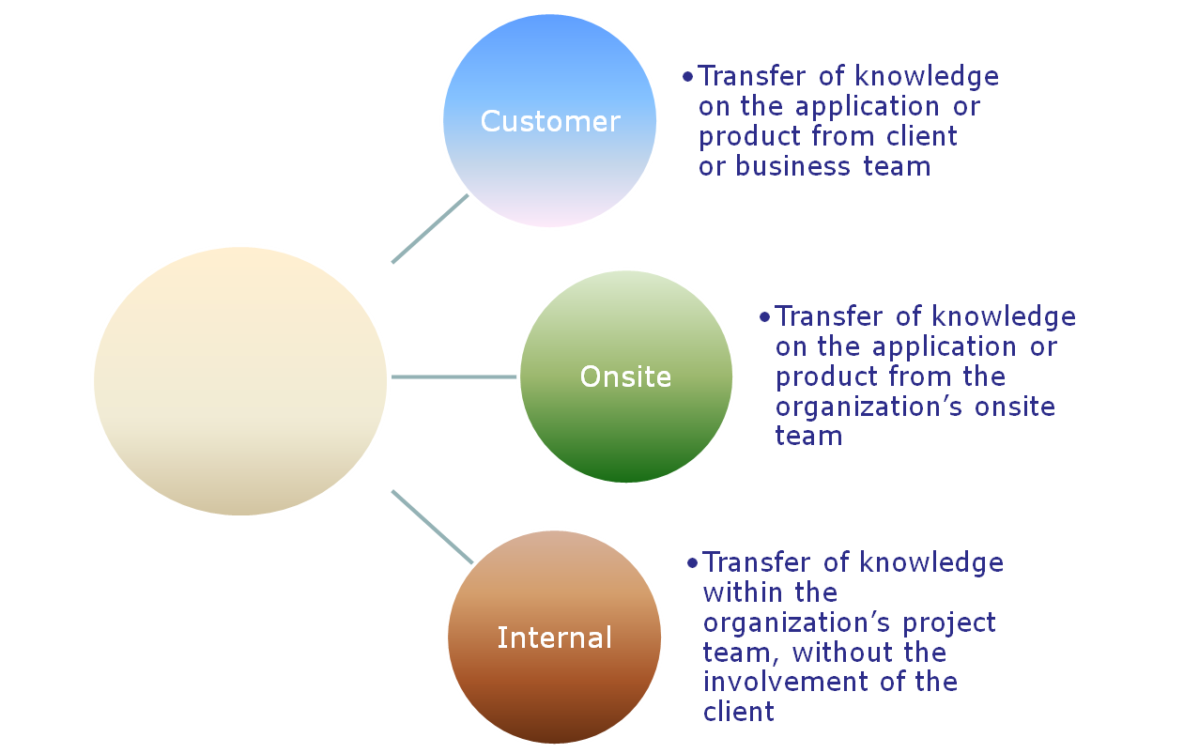
Sources of Knowledge Transition
Source

Slide 12
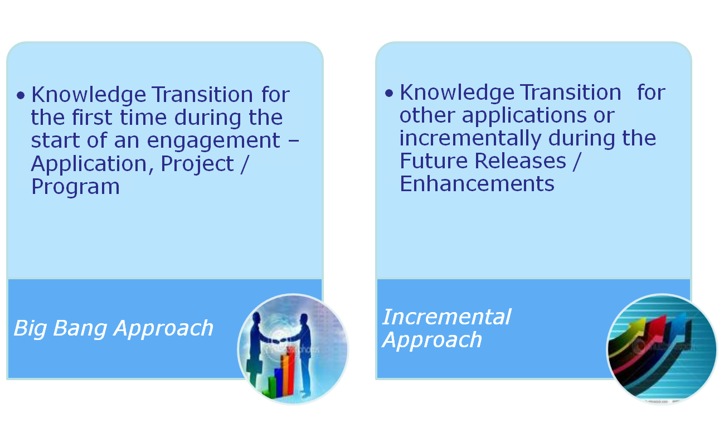
Types of Knowledge Transition

Slide 13
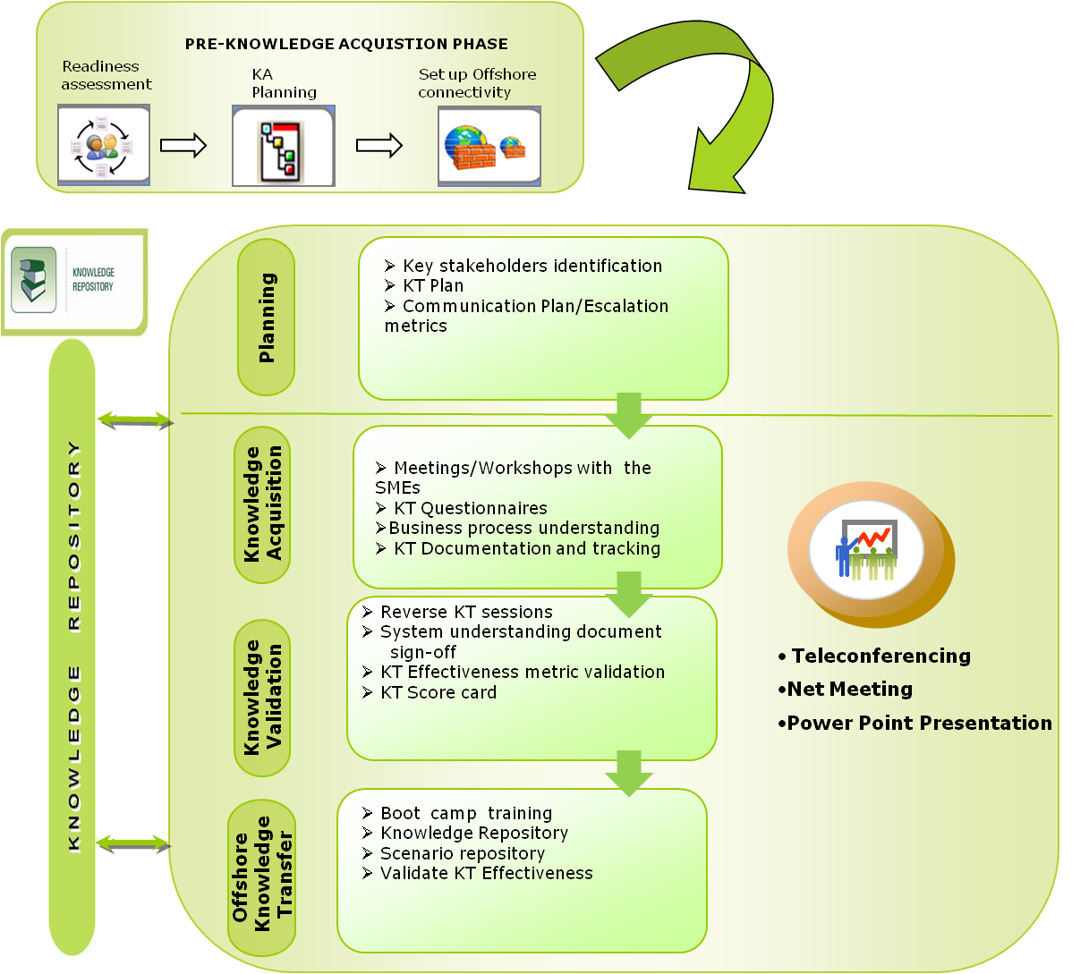
Cognizant’s Knowledge Transition Methodology
Following diagram illustrates how Knowledge Transition is typically carried out in a systematic manner in Cognizant

Slide 14
Transition Planning
This is the first phase within Transition
The objective is to ensure readiness of the project team as well as the client to begin the KT – both from a resource and infrastructure perspective
Discussions are held between the transition team and the client stakeholders to chart out detailed day to day plan for the KT
This phase involves developing transition plan or review of existing/pre-developed knowledge transition plans and offshore transition planning

Slide 15
Transition Planning (Contd.)
The Knowledge Transfer Plan is a complete, stand-alone document that provides the following information:
  Scope (in-scope and out of scope)
  Transitioning Strategy
  Applications services taking into account each functional area with business line
  Transition Schedule
  KT Calendar
  Receivables and Deliverables during each phase
  Hardware Software requirements

Slide 16
Transition Planning (Contd.)
  Escalation Process
  Status Reporting
  Progress Review/Team Meetings
  Milestones
  Resource Management Plan
  Training Process
  Risk and Mitigation Strategy

Slide 17
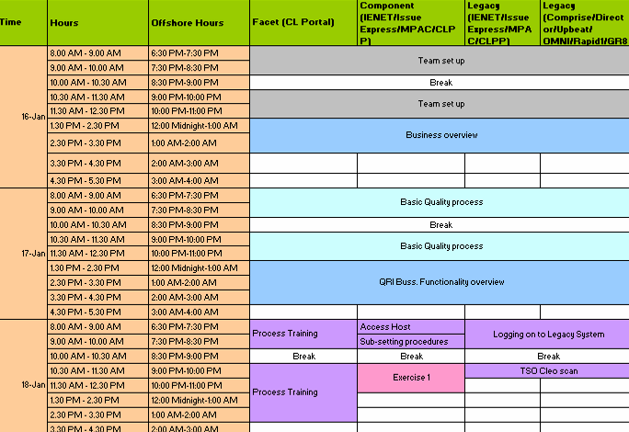
Sample KT Plan
Date & Onsite Time
Offshore Time
Application Tracks
Video Recording
Video Conference
Global Crossing
Global Crossing

Slide 18
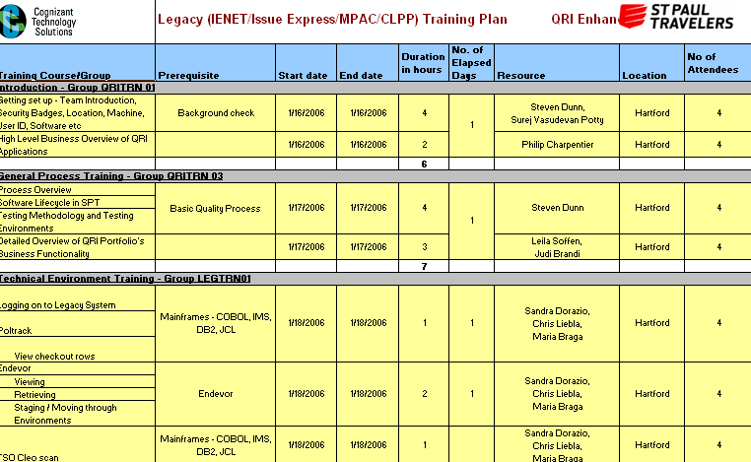
Sample KT Calendar
Training Type
Business Training Subject
Business SME
Technical / Application Lead
Technical Training Subject

Slide 19
Knowledge Acquisition
During this phase, the testing team (primarily onsite resources) interact with the client SMEs (subject matter expert) to gain understanding of the following:
  Business process flows
  Application functionality
  QA processes
  QA tools usage
Knowledge Acquisition happens through class room sessions, documentation sharing and self study and hands-on training on the application

Slide 20
Knowledge Acquisition (Contd.)
Generally there is a daily plan for the class room and other knowledge sharing sessions scheduled between the SMEs and the incumbent testing team
Knowledge is typically acquired by the onsite team from the client SMEs and is passed on to the offshore team on daily basis
KT effort variation, schedule variation and effectiveness are continually monitored during this phase

Slide 21
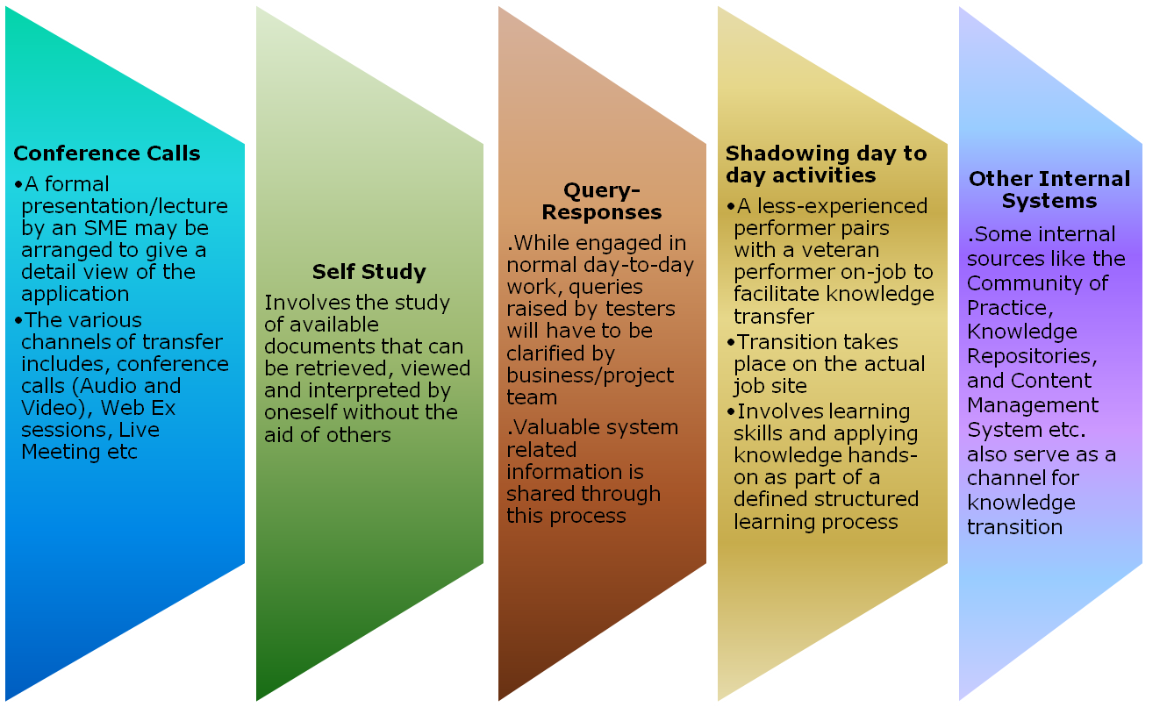
Modes of Knowledge Transition

Slide 22
Knowledge Validation
The knowledge acquired by the incumbent team during KT is captured in various application and process understanding documents
The knowledge level of the transition team is validated in the following ways:
  Understanding documents – Reviewed by SMEs for completeness and clarity
  Application Walkthrough – Transition team walks through the application navigation to the client SMEs
  Feedback from SMEs– The knowledge level of the transition team is rated on several parameters by the client SMEs and the overall score needs to be above the predetermined threshold for the KT to be signed off
The process is also called Reverse Knowledge Transition

Slide 23
Reverse Knowledge Transition
Reverse knowledge transition is simply the flow of knowledge in a direction opposite to the standard hierarchical top-down approach
It helps in evaluating the effectiveness of knowledge transition
After acquiring knowledge from client/onsite, the project team prepares an understanding document and shares it with them, to make sure that their understanding is correct
Instrumental in demonstrating the knowledge acquired from the transition

Slide 24
Knowledge Retention
Knowledge retention deals with ways to capture knowledge “before it walks out the door” and avoid “reinventing the wheel.”
In order to retain and disseminate the acquired knowledge, a framework must be set up
It will help to put up a Knowledge Management system, or organizational learning system, to gradually build up a body of knowledge both in recorded form, and shared by the team
A system such as this will require the following:
  A place to store practice knowledge – tips, hints, manuals, guides, and other team documents. Example – a team SharePoint site, and document library
  A set of processes for reviewing ongoing activity. These might include After Action reviews of new contracts or new projects. Lessons learnt from these will be stored in the knowledge store (above)

Slide 25
Allow time for questions from participants

Slide 26
Test Your Understanding
Fill in the blanks:
  ______________ is the process of the project team gaining information on the application from the client/SME.
    a) Requirement Elicitation
    b) Requirement Analysis
    c) Knowledge transition
    d) Big Bang KT
  Knowledge Transition for the first time during the start of an engagement – Application, Project / Program is referred to as ______________
    a) Requirement Elicitation
    b) Reverse Knowledge Transition
    c) Incremental KT
    d) Big Bang KT
Notes:
Answers
A.1 - c
A.2 - d

Slide 27
Requirement Gathering and Analysis

Slide 28
Requirements Gathering
On the successful completion of reverse knowledge transition, the project team starts gathering requirements
Requirements are a description of how a system should behave or a description of system properties or attributes
Requirements gathering involves the task of communicating with customers and users to determine what their requirements are
Testers should interact closely with multiple work-groups, often with conflicting goals, to arrive at a bonafide requirements list

Slide 29
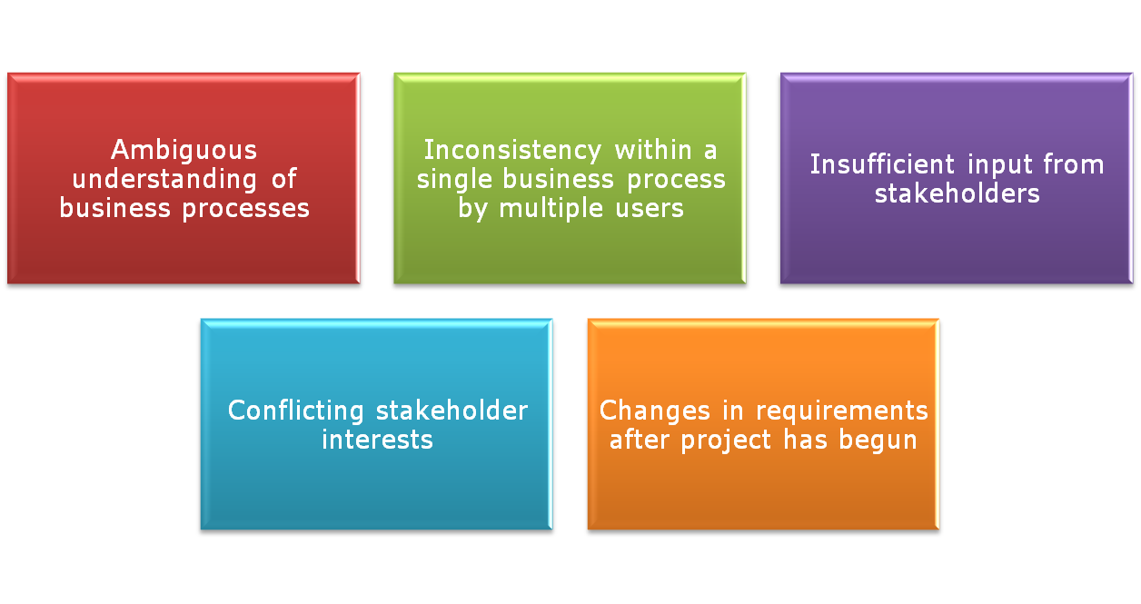
Requirements Gathering (Contd.)
Some of the common issues faced during requirements gathering

Slide 30
Requirements Gathering (Contd.)
Currently, organizations have started to use tools that are better equipped to handle the complex and multilayered process of requirements gathering
Some of the tools used are:
  Prototypes
  Use cases
  Data flow diagrams

Slide 31
Prototypes
Prototypes are “Mockups” of an application
Helps users to get an idea of what the system will look like, and makes it easier to make design decisions without waiting for the system to be built
Major improvements in communication between users and developers were often seen with the introduction of prototypes
Early views of applications led to fewer changes later and hence reduced overall costs considerably

Slide 32

Use Cases
A use case is a set of scenarios that describes an interaction between an user and a system
Use cases capture who (actor) does what (interaction) with the system, for what purpose (goal), without dealing with system internals
A complete set of use cases specifies all the different ways to use the system, and therefore defines all behavior required for the system, bounding the scope of the system
Actor
Process

Slide 33
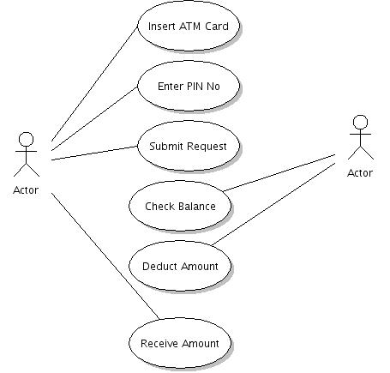
Use Cases (Contd.)
Use Case Diagram Example: (ATM Machine)

Slide 34
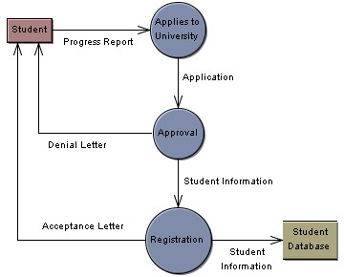
Data Flow Diagrams
A data flow diagram (DFD) is a graphical representation of the "flow" of data through an information system
Example of a Data Flow Diagram

Slide 35
Requirement Analysis
A requirement is:
  A high-level statement of the system
  A statement that identifies a necessary attribute, capability, characteristic, or quality of a system in order to have value and utility for a user
  Statement of the business need from the client to the developer or tester
  A specification of what has to be built
  Description how the system should behave

Slide 36
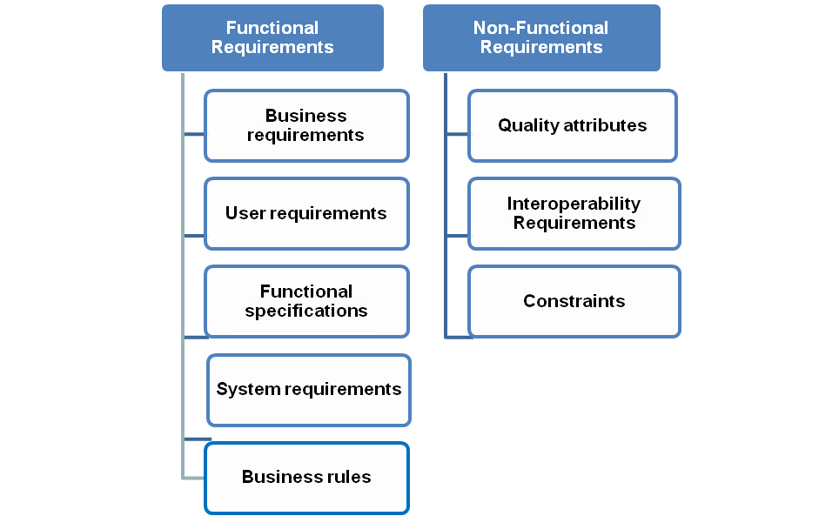
Requirement Types
Mainly based on the functionality of the system it is classified as Functional and Non- functional requirements

Slide 37
Functional Requirement Type
Functional Requirements
  Describes the functions that the system needs to execute
  Statements of services the system should provide
  Explains how the system should react or behave to particular inputs
  Depends on the type of software, expected users and the type of system where the software is used
  It can be further categorized as Business Requirements, User Requirements, Functional Specifications, Business Rules and System Requirements

Slide 38
Functional Requirement Type (Contd.)
Business Requirements
  A specification of simply what the business wants
  Usually expressed in terms of broad outcomes the business requires, rather than specific functions the system may perform
  Represents high-level objectives of the organization or customer who requests the system
  Describes why the organization is implementing the system—the objectives the organization hopes to achieve
  Describes the business objectives, scope of the project, business constraints, current business process
  Example – Business requirement for an ATM would be – ATM should allow the withdrawal of given amount from the account with a cap on maximum amount and number of withdrawals

Slide 39
Functional Requirement Type (Contd.)
User Requirements
  Document describing the user goals, tasks or activities that the users must be able to perform with the product and the flow of the system
  Describes functional and non-functional requirements so that they are explicable by system users who don’t have detailed technical knowledge
  Requirements might be represented in form of tables and diagrams
  Conveys how the system should interact with the end user or to another system to achieve a specific business goal
  Example – The system shall complete a standard withdrawal from a personal account, from login to cash, in less than two minutes for a first-time user

Slide 40
Functional Requirement Type (Contd.)
Functional Specifications
  Specifies what has to be done by identifying the necessary task, action or activity that must be accomplished
  Specifies the software functionality that the developers must build into the product
  Also called behavioral requirements
  Useful for developers to build the product and testers to create test cases
  Describes the existing process, new process, use cases, process flow and reporting requirements
  Example – The system shall provide users with the ability to select whether or not to produce a hardcopy transaction receipt before completing a transaction

Slide 41
Functional Requirement Type (Contd.)
System Requirements
  Describes the top level requirements for a product that contains multiple sub-systems
  A system can be all software or it can include both software and hardware sub-systems
  Structured document having detailed description about the system
  Users are system end users, software developers and system architects
  Example:
    The ATM shall communicate to the Bank via the Internet
    The ATM shall issue a printed receipt to the customer at the end of a successful session

Slide 42
Functional Requirement Type (Contd.)
Business Rules
  A constraint to be considered on the aspect of a business while developing a product
  Includes industry standards and computational algorithms
  Requires that specific functionality to be implemented to ensure that the system enforces or complies with those rules
  Used to control internal system processing based on specific combinations of data values, system states, conditions, or other user-defined criteria
  Example:
    Limit is $1000 a day (24 hour window)
    No more than three withdrawals per day (24 hour window)

Slide 43
Non-Functional Requirement Type
Non-Functional Requirements
  Refers to the constraints on the services offered by the system such as time constraints, constraints on the development process, standards, etc
  Defines the system properties and constraints e.g. reliability, response time, storage requirements, scalability, usability and security
  Can be further categorized as Quality attributes, External interfaces and Constraints

Slide 44
Non-Functional Requirement Type (Contd.)
Quality Attributes
  Describes the system’s characteristics in various dimensions that are important either to users or to developers and maintainers.
  Quality attributes of a system include availability, performance, usability, portability, integrity, efficiency, robustness, and many others
  These characteristics are called quality factors or quality of service requirements
  Example:
    All displays shall be in white 14 point Arial text on black background
    It must be able to perform in adverse conditions like high/low temperature etc

Slide 45
Non-Functional Requirement Type (Contd.)
Interoperability Requirements
  Could be interfaces between the system application and other applications, interface between the system application and other hardware or devices like printers, bar code readers, interface to human users or communication interfaces to exchange information
  Example:
    User Interfaces: The customer user interface should be intuitive, such that 99.9% of all new ATM users are able to complete their banking transactions without any assistance
    Hardware Interfaces: The hardware should have following specifications:
      Ability to read the ATM card
      Ability to count the currency notes

Slide 46
Non-Functional Requirement Type (Contd.)
Constraints
  Design and implement constraints, which are restrictions imposed on the choices available to the developer for some legitimate reason
  The common area of constraints on the application are reliability, performance, security, usability and safety
  Constraints may be user constraint or system constraint
  Requirements prescribing stipulations or limitations on how the system can be built
  Example: The cabin door will always be locked, which will open only when user swipes his/her ATM card in the slot & is validated as genuine

Slide 47
Analysis of Requirement Specifications
Requirements Analysis is the process of understanding the customer needs and expectations from a proposed system or application
A variety of requirement tests can be applied to ensure that each requirement is relevant
Following is the checklist that can be used by testers during the requirements phase to verify the quality of requirements:
  Correctness (Do the requirements reflect the user’s needs? Are they stated without error?)
  Completeness (Have all functional and quality requirements described in the problem statement been included?; Are all the necessary elements present? )
  Consistency (Do any requirements contradict with each other?)
  Clarity (It is very important to identify and clarify any ambiguous requirements)

Slide 48
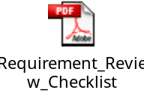
Analysis of Requirement Specifications (Contd.)
  Relevance (Is the requirement pertinent to the problem area? Requirements should not be superfluous);
  Redundancy (A requirement may be repeated; if it is a duplicate, it should be combined with an equivalent one);
  Feasibility (Can the requirements be implemented given the conditions under which the project will progress?)
  Testability (Can each requirement be covered successfully with one or more test cases? Can tests determine if the requirement has been satisfied?)
  Sample Requirement Review Checklist

Slide 49
Prioritization of Requirements
Prioritization allows everyone to understand the relative value to stakeholders of the requirement
Why Prioritization?
  Time constraints- Need to know what to test ???
  Resource/Budget constraints – Need to decide how much to test??
  Special focus on Critical business areas, which need to be tested earlier in the testing cycle
  Need for early defect detection
  Traditional testing approach focuses on over-testing of less critical areas

Slide 50
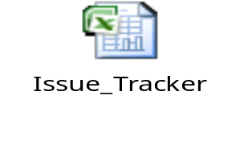
Clarification Management
A requirement can be tested and clarified by asking the stakeholders detailed questions
Clarifications that were posted should be tracked and can be used as a knowledge repository for the project
The tracker is usually referred to as the “Clarification Tracker” or “Issue Tracker”
Testers should list all the clarifications with an “Open” status and should assign the responsible stakeholder
The stakeholder should revert back with answers to the clarifications with status as “Closed” or if waiting for more information should change the status as “In Progress”
Tester, if not clarified with the answer should provide additional information and change the status to “Re Open”
Template for issue tracker

Slide 51
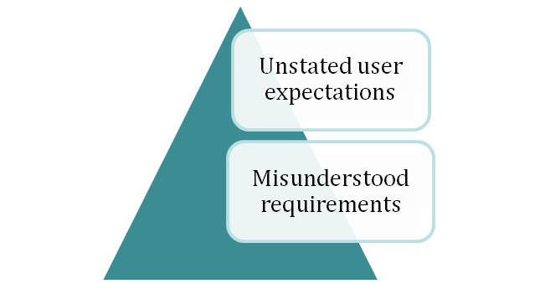
Requirement Defects
The beginning of the software life cycle is critical for ensuring high quality in the software being developed
Defects injected in the early phases can persist and be very difficult to remove in later phases. Hence defect prevention is most effective during the requirement analysis phase
Since many requirements documents are written using a natural language representation, there are very often occurrences of ambiguous, contradictory, unclear, redundant and imprecise requirements

Slide 52
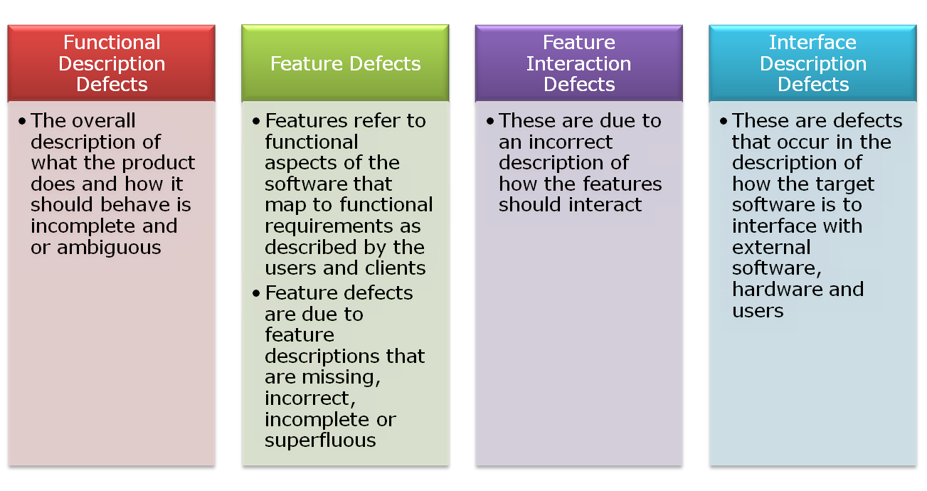
Requirement Defects (Contd.)
Common requirements/specification defects:

Slide 53
Requirement Change Management
Requirements management is the process of managing changing requirements during the requirements engineering process and through system development and release
Often requirements are incomplete and inconsistent and of course new requirements emerge during the process as the business needs change
Regardless of the type of requirement you are working with, managing change to the set or any of the individual parts should be handled in a uniform fashion, like below:
  Automatically communicate the intent to change
  Control the acceptance or approval of change
  Enable the analysis of the impact of the change
  Track the actual changes made and communicate the implemented change to all impacted or interested stakeholders

Slide 54
Requirements Coverage
Objective measurement of how thoroughly requirements are demonstrated
Requirements coverage views focus on the localization of the requirements in the rest of the system
Traceability of each requirement to all test cases that exercise that particular requirement
Some tools offer the capability of mapping requirements to the other project artifacts, such as, use cases, test cases and design documents. Others prefer to follow simple spreadsheet based traceability matrix of requirements to various other artifacts

Slide 55
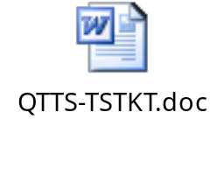
System Understanding Document
Testers can reverse present to the Stakeholders (Business analysts, System analysts etc.) their understanding of requirements through the understanding document
Acts as evaluation criteria for the testers and also helps in establishing common understanding between all the stakeholders
Acts as a knowledge repository document for future use
Template for Application understanding document

Slide 56
Identified Testable and Non-Testable Requirements
At the end of the requirements analysis phase, the testers should have a clear picture of the requirements and the categorized testable and non-testable requirements
A testable requirement is a requirement that has been broken down to a level where it is precise, unambiguous, and not divisible into lower level requirements. These criteria are only met if it is possible to write a test case that would validate whether the requirement has or has not been implemented correctly
Example:
  The ATM shall issue a printed receipt to the customer at the end of a successful session. The receipt shall contain:
    Date and time,
    Machine location,
    Account information,
    Amount of the transaction
    Available balance

Slide 57
Identified Testable and Non-testable Requirements (Contd.)
Non-testable requirements :
  Requirements which are too subjective
  Requirements that are not verifiable, i.e. for which test cases cannot be devised
  Requirements with attributes that cannot be quantified
  Example:
    The application/product should be user friendly.
    The search engine should return valid information for any query raised by the user.
    The system should be robust.

Slide 58
Requirements Traceability Matrix (RTM)
Requirements traceability defines a relationship between two or more requirements
Tracing requirements to other requirements helps ensure that no requirements are inadvertently overlooked during the testing process
When analyzing the impact of a change proposed in a specific requirement, the traceability links indicate other requirements that might be affected by the change
Ensures that each requirement is identified in such a way that it can be associated with all parts of the system where it is used

Slide 59
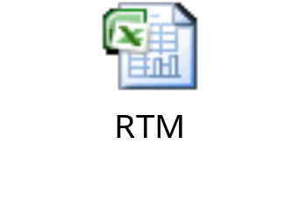
Requirements Traceability Matrix (Contd.)
The following are the components of the RTM:
  Test Requirement
  Test Scenarios
  Test Cases
  Test Logs / Defect Ids
It can be established in the Quality Center (a test management tool) and also in an excel spreadsheet
Template for traceability matrix

Slide 60
Application Development Vs Maintenance
 | KT & Requirement Analysis
Application Development | Big Bang approach for KT Gather requirements Analyze all the requirement specifications and raise ambiguities if any Preparation of system understanding document
Application Maintenance | Incremental approach for KT Perform Impact Analysis Analyze the requirements related to change requests and raise ambiguities if any Update the existing knowledge base

Slide 61
Allow time for questions from participants

Slide 62
Test Your Understanding
Choose the correct answer:
  Defect prevention is most effective during which phase
    a) Test Design
    b) Requirement Analysis
    c) Knowledge Transition
    d) System Testing
  A requirement is said to be complete when
    a) No necessary elements are missing from the requirement
    b) Confirms that it is possible to create a test for the requirement
    c) It can be implemented within the given budget
    d) It can be implemented within the given schedule
Notes:
Answers
A.1 – d
A.2 - a

Slide 63
Time for a break!!

Slide 64
Requirements Management Tools

Slide 65
Requirements Management Tools
Requirements management is the process of documenting, analyzing, tracing, prioritizing and agreeing on requirements and then controlling change and communicating to relevant stakeholders
It is a continuous process throughout a project
Requirements management tools help us to manage and track requirements effectively

Slide 66
Requirements Management Tools
(Contd.)
Some of the common requirement management tools are listed below:
  Doors - Requirements Management Tool by IBM
  IBM Rational DOORS helps increase quality, improve requirements communication, collaboration, and verification across the enterprise
  Requisite Pro - Requirements Management Tool by IBM
  Rational RequisitePro is a use case writing tool to help improve communication and traceability, enhance collaborative development, and integrate requirements throughout the lifecycle

Slide 67
Quality Center: Requirements Module
The Requirements Management module in Quality Center helps capture, manage and track requirements throughout the development and testing cycle
Key Features:
  Manage different types of requirements throughout the application lifecycle
  Store requirements centrally with native control and base-lining capabilities
  Graphically represent and map requirements to business processes
  Share and reuse application requirements
  Manage user stories for Agile projects
  Align testing priorities based on business risk and establish requirements traceability

Slide 68
Requirements Module: Overview
It is possible to display requirements in the following views:
  Requirements Tree
  Requirement Details
  Requirements Grid or Coverage Analysis

Slide 69
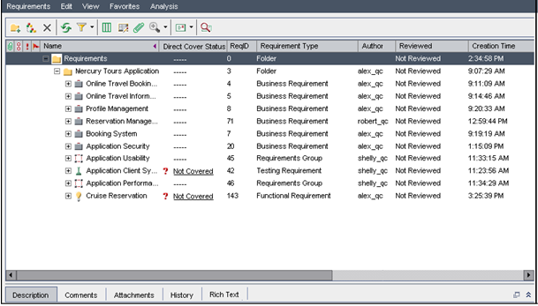
Requirements Tree
The Requirements Tree view display requirements in a tree

Slide 70
Requirements Tree (Contd.)
Key Elements in Requirements Tree view:
  Requirements Menu Bar: Displays drop-down menus of Requirements module commands
  Requirements Toolbar: Contains buttons for commonly used, when creating and modifying requirements
  Indicator Columns: Indicates that the specified requirement has attachments, linked defects, alerts and follow-up flags
  Requirements Tree: Displays requirements in a tree
  Information Panel: Displays the following tabs – Description, Comments, Attachments, History and Rich Text

Slide 71
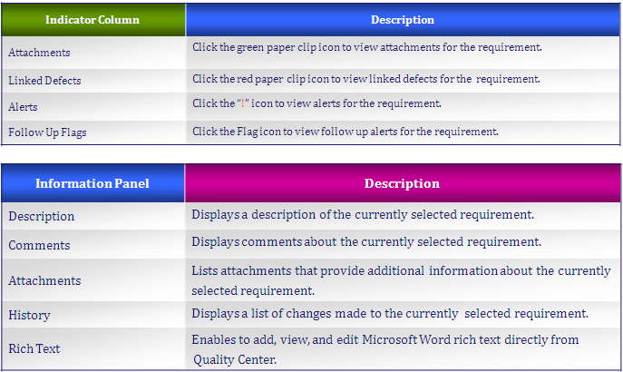
Requirements Tree (Contd.)

Slide 72
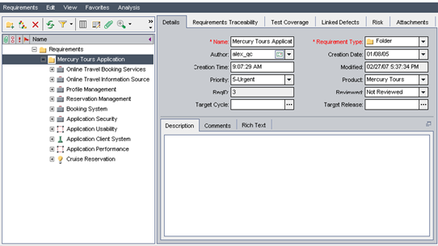
Requirement Details
Displays requirements for the tests they are associated, requirements with which they are traced, and defects with which they are linked
Enables to calculate and analyze requirement risks

Slide 73
Requirement Details (Contd.)
Key elements in Requirements Detail view (apart from showing in requirements tree):
  Requirements Traceability Tab: Lists the requirements linked to the currently selected requirement
  Test Coverage Tab: Lists the test with the currently selected requirement
  Linked Defects Tab: Lists the defects linked to the currently selected requirement
  Risk Tab: Calculates and analyzes requirement risks
  Attachments Tab: Lists the attachments that provide additional information about the currently selected requirement

Slide 74
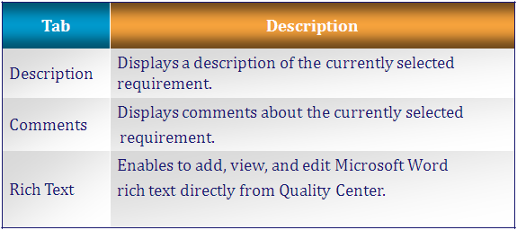
Requirement Details (Contd.)
Details Tab: Displays details about the currently selected requirement

Slide 75
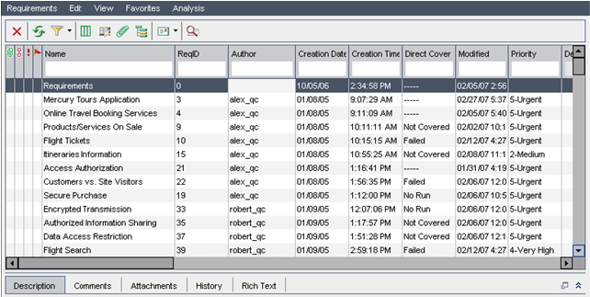
Requirements Grid
Display requirements in a flat non-hierarchical view
Each line in the grid displays a separate requirement

Slide 76
Requirement Grid (Contd.)
The requirements grid view contains the following key elements:
  Requirements Menu Bar
  Requirements Toolbar
  Indicator Columns
  Information Panel

Slide 77
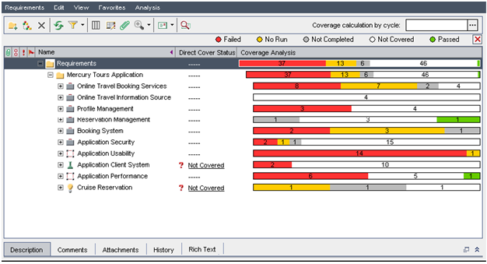
Coverage Analysis
To analyze the breakdown of child requirements, according to test coverage status

Slide 78
Coverage Analysis (Contd.)
The coverage analysis view contains the following key elements:
  Requirements Menu Bar
  Requirements Toolbar
  Indicator Columns
  Requirements Tree
  Information Panel

Slide 79
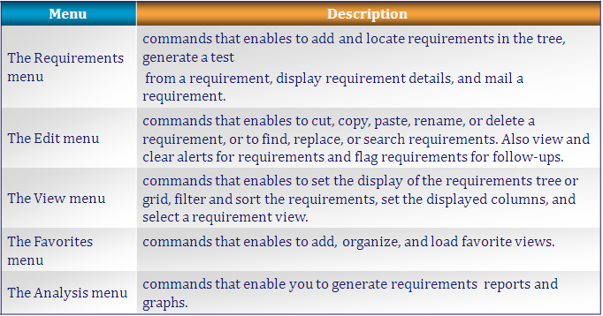
Requirements Menu Bar
The requirements menu bar has the following options:

Slide 80
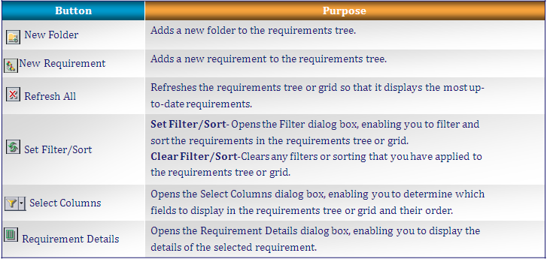
Requirements Toolbar
The Requirements Toolbar has the following buttons:

Slide 81
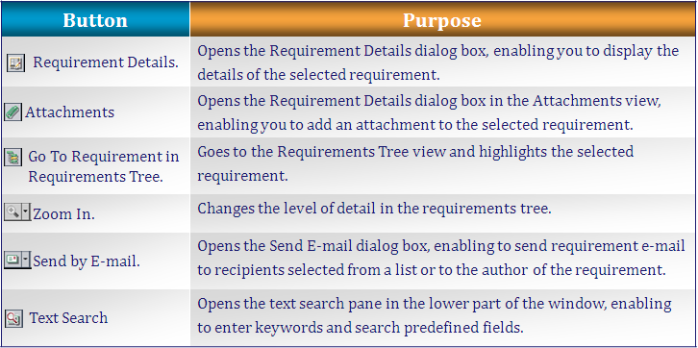
Requirements Toolbar (Contd.)

Slide 82
Requirement Fields
The Requirement module displays the following fields:
  Author: The user name of the person who created the requirement
  Comments: Displays comments about the requirements
  Creation Date: The date on which requirement was created
  Creation Time: The time at which requirement was created
  Description: A description of the requirement
  Modified: Indicates the date, when the requirement was last changed
  Name: The requirement name

Slide 83
Requirement Fields (Contd.)
Requirement Type indicates the type of requirement; default values are:
  Business: A business process requirement
  Folder: A folder for organizing requirements
  Functional: A system behavioral requirement
  Group: A collection of related requirements
  Testing: A system performance requirement
  Undefined: An undefined requirement

Slide 84
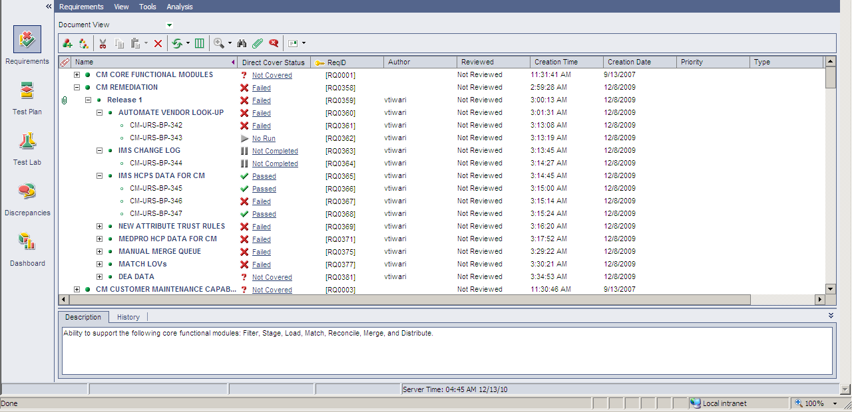
RTM in QC

Slide 85
Allow time for questions from participants

Slide 86
Tips
Real-time Challenge: Requirement changes during the course of the project
Solutions :
  Have a clearly defined process for receiving, analyzing and incorporating change requests, and make your customer aware of his/her entry point into this process
  Set milestones for each testing phase beyond which certain changes are not permissible -- for example, disallowing major changes once the testing for a module reaches 75 percent completion
  Ensure that change requests (and approvals) are clearly communicated to all stakeholders, together with their rationale, and that the master project plan is updated accordingly
Notes:
This is the content slide. Enter the content for the topic in this slide. Ensure that comprehensive speaker notes are available for each slide.

Slide 87
Test Your Understanding
Fill in the blanks:
  ______________ document is a way to evaluate the understanding of testers on the overall system\requirements.
    a) System evaluation
    b) System understanding
    c) Requirement review
    d) Requirement stability
  ______________ defines a relationship between two or more requirements.
    a) Testability
    b) Reliability
    c) Traceability
    d) Requirement stability
Notes:
Answers:
A.1 - b
A.2- c

Slide 88
Knowledge Transition and Requirement Analysis Session [1]: Summary
The Knowledge Transition and Requirement Module at a glance:
  Introduction to Knowledge Transition and Requirements Analysis
  Importance of tester involvement in these phases
  Knowledge Transition Concepts – Sources, Modes & Phases Involved
  Requirement Analysis and Verification
  Requirements Change Management
  Tools & Deliverables

Slide 89
Knowledge Transition and Requirement Analysis Session [1]: Source
Websites
  www.sqaforums.com
  www.qualityworld.com
Books
  Software Engineering: A Practitioner's Approach, seventh edition by Roger Pressman
  HP Education Services QC Students Guide
  Cognizant Academy. Software Testing. Cognizant Technology Solutions, 2004
Disclaimer: Parts of the content of this course is based on the materials available from the Web sites and books listed above. The materials that can be accessed from linked sites are not maintained by Cognizant Academy and we are not responsible for the contents thereof. All trademarks, service marks, and trade names in this course are the marks of the respective owner(s).

Slide 90
You have completed the Session 1 of Knowledge Transition and Requirement Analysis.
Notes:
Enter the course title.
Enter the knowledge level that will be addressed through this course.

